Slide 1
Viz’Affluence
Défi 1
Tous acteurs de la mobilité en Île-de-France

Slide 2
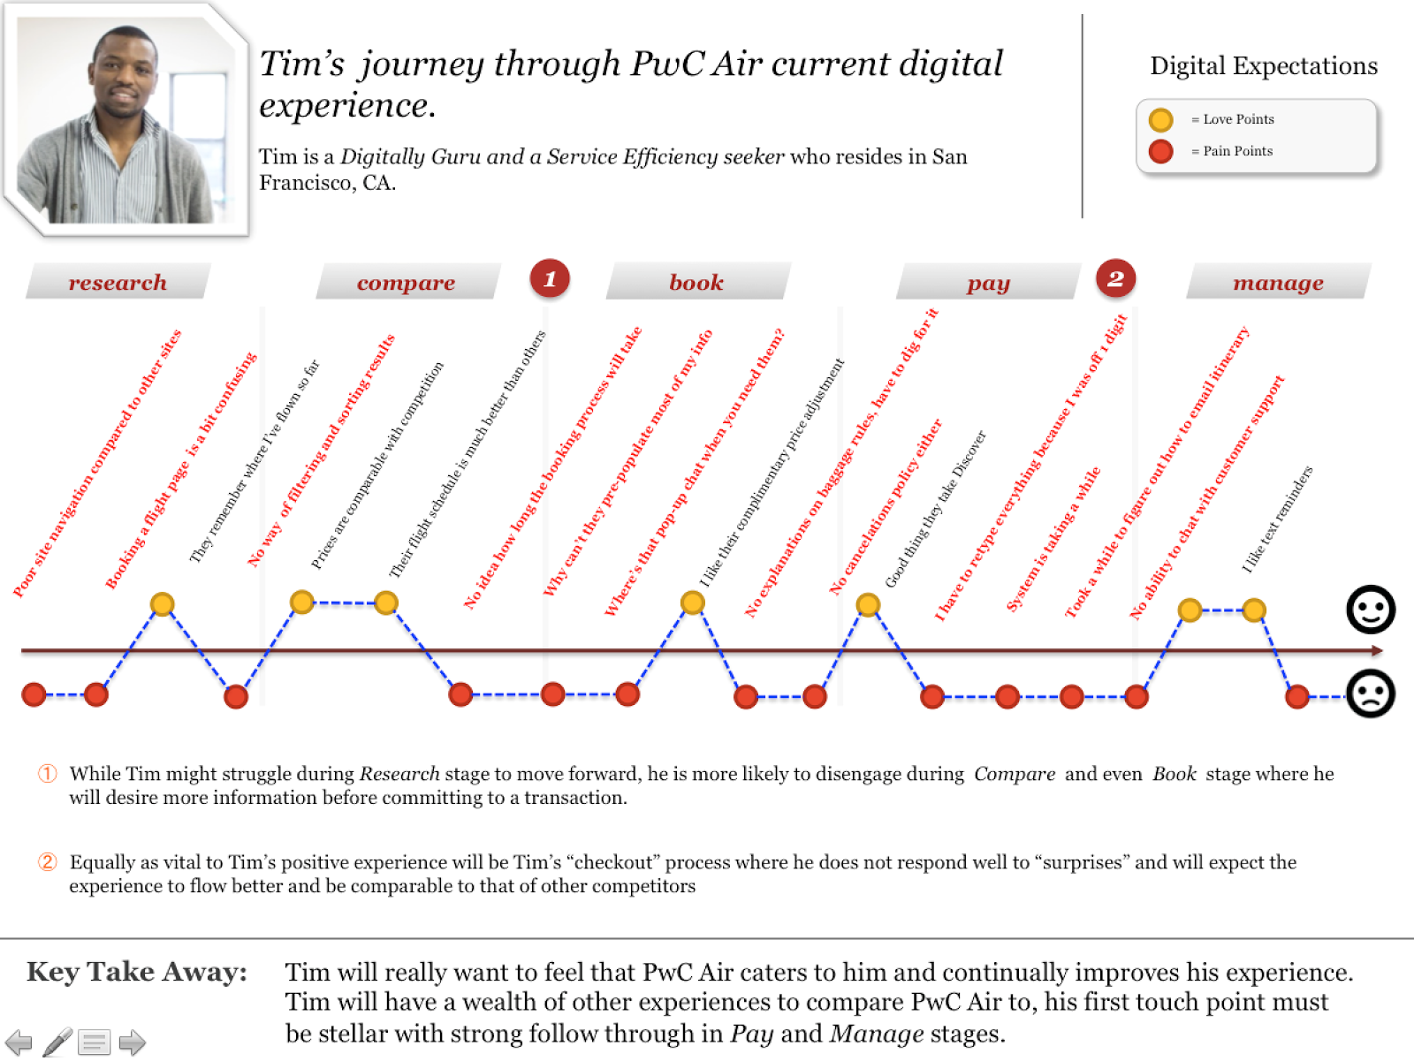
Customer
Journey
Example
“
My Persona Name
This a quote to provide context into my personality
”
Functional Role
“
This a quote to provide context into my personality
”
“This a quote to provide context into my personality”

Slide 3






5
2
+
1
6
3
4
1
Randy, a physician recruiter, work planner, is notified in his console of new candidates. He is able to review and process applications from his mobile device.
2
Joe, a recent appendectomy patient, is able to review his treatment schedule, plan, and continue communication with medical providers he meets in the hospital during his visit.
3
When Anika signs in for her nursing shift, she can easily see a snapshot of what has been done for each patient so far, saving her time when she begins rounds.
4
Oliver, a resident surgeon, can view open positions within the hospital system as well as upcoming appointments at a glance.
5
The HR admin, Tanya, can easily see where in the process each candidate is at any given time. This allows her to accurately communicate with each applicant as needed.
6
Alice and her husband recently relocated to Louisville. She’s a nurse practitioner and is searching for new roles to grow her career in the area. The [CLIENT] system’s ease of use motivates her to continue searching within the hospital.

Slide 4





Future State Persona | Crew Lead
WHERE DOES THIS ROLE EXIST?
[JURISDICTION]
MY NEW DAY IN THE LIFE
[IMAGE]
Discuss assigned work with supervisor during morning meeting
Pick up iPad and log into Field Serving Lightning to see the work that is scheduled to be completed by M&C crew
Supervise work completion
MY ROLE I am responsible for responding to, investigating, and repairing all types of leaks. I lead a small crew of more junior technicians in the field. I am additionally tasked with completing paperwork and reports across multiple systems that summarize what we did in the field in order to close out the leaks.
Drive back to the yard and enter time into SAP Fiori
Complete the work order, following the step by steps indicated on the iPad based on the work type. Access Lemur to view maps on the job
KEY CHANGES
I will use FSL on my iPad to complete jobs
I will view maps in Lemur on my iPad
I will enter time directly into SAP Fiori

Slide 5
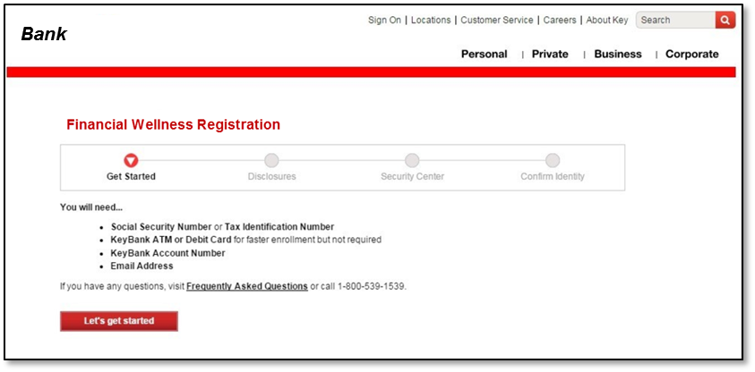

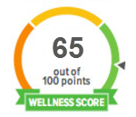
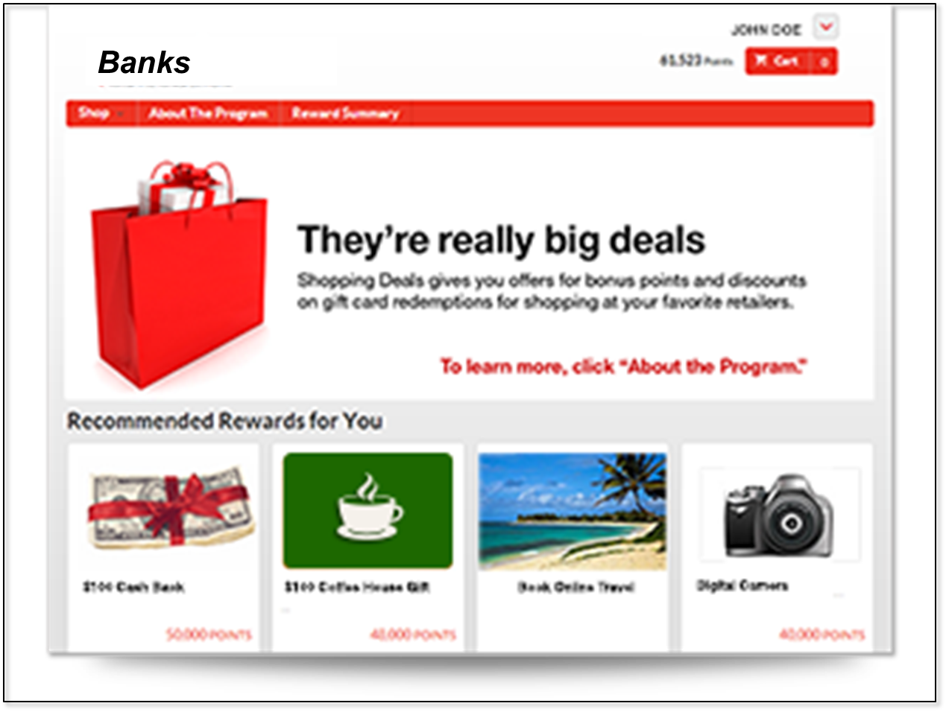
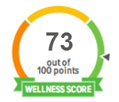
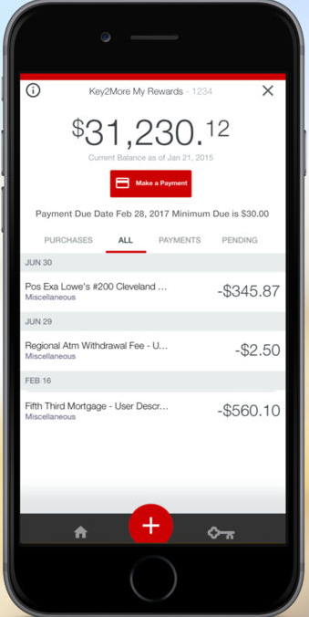
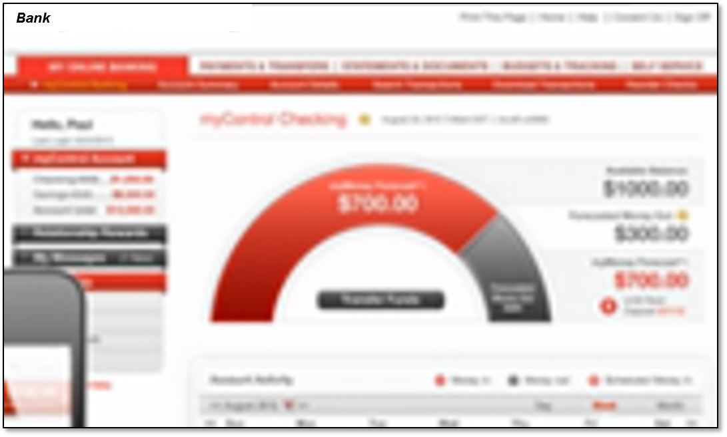
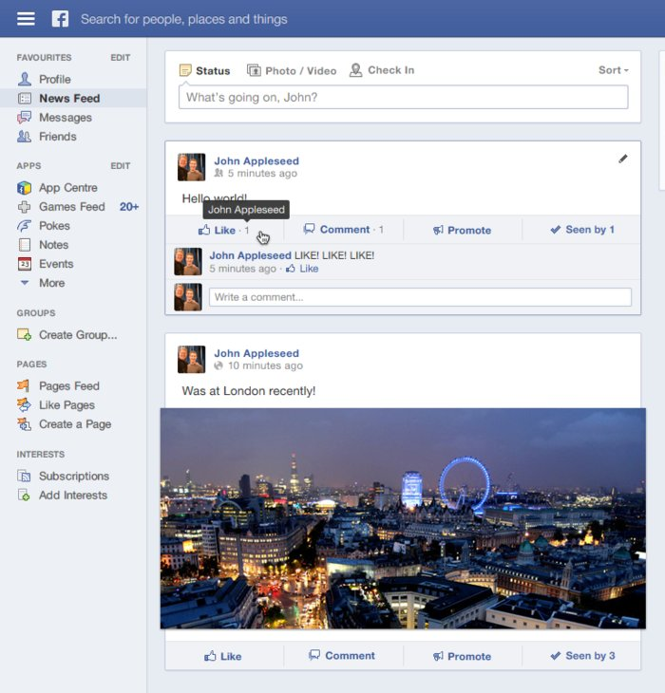
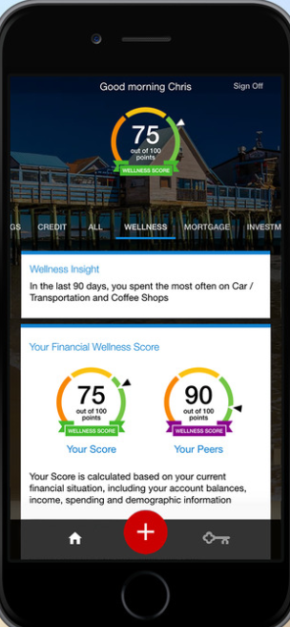
Customer Journey #1 - Financial Wellness Goals and Advice
Needs Assessment & On Boarding– “Help me”
Two days later, Mary decides to sign up for the Financial Wellness tool and she logs into her account online. She completes a simple needs assessment in the tool, goes through confirmation and eSign. She then completes a budget in the Financial Wellness tool to start managing her spending.
Mary responds to an offer from her bank and begins receiving personalized advice
Rewards & Offers
Mary’s Wellness score has improved. As a reward, her bank offers her a discount at the local Nike store, knowing she has registered for an upcoming marathon based on her linked data.
Mary
Age 24, Teacher
Personalized Marketing & Sales - “Know me”
3
Goals based recommendations
After logging into her mobile banking account using biometrics, she clicks a tailored marketing message offering her tools to help manage her finances. Mary is interested in the Financial Wellness tool, she reviews the tool’s functionality and decides to think about if she will sign up or not.
Current State
Only has one checking account and one low limit credit card
Immediate short term goal to reduce credit card debt and improve her credit score
Long term goal to pay off student loans and eventually purchase a house
5
2
1
Ongoing Engagement – “Next Best Offer”
4
Customer Targeting - “Recognize me”
Over the next month Mary checks her Financial Wellness tool frequently on her mobile and online and notices that she has been spending less. She regularly receives additional personalized messages that suggest how she can continue to improve her Wellness score.
Mary sees an advertisement on Facebook offering to help her reduce her credit card debt.

Slide 6
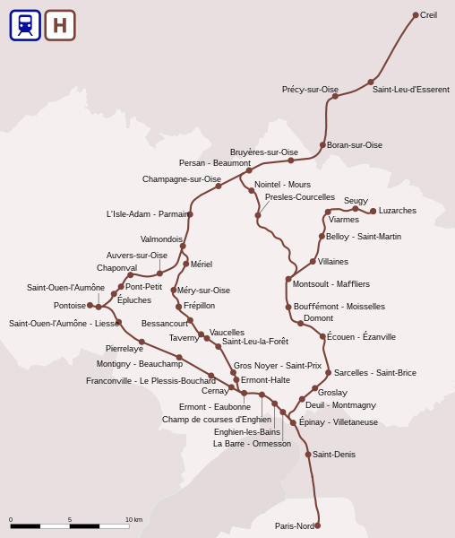
Défi 1 - Viz’Affluence
Facultatif: phrase d’accroche
Les enjeux:
Rappel du contexte, de la problématique et les résultats escomptés
N’hésitez pas à vous appuyer sur des données concrètes afin d’objectiver les enjeux (ex: durée des retards, taux de satisfaction…)
Tous acteurs de la mobilité en Île-de-France

Slide 7
Critères d’évaluation transmis au jury
Facultatif: phrase d’accroche
• La pertinence du projet proposé au regard du thème du Hackathon,
• Le caractère innovant et l’originalité du projet,
• La faisabilité du projet et sa rapidité de mise en œuvre,
• La création de valeur pour les acteurs de la mobilité et les usagers
• L’aboutissement du projet,
• La simplicité d’utilisation des interfaces utilisateurs.
Pensez à bien supprimer cette page lors de votre présentation!
Tous acteurs de la mobilité en Île-de-France

Slide 8
Défi 1 - Viz’Affluence
Facultatif: phrase d’accroche
Le moyen mis en œuvre
Une phrase de présentation de la solution + renvoi vers une maquette, des captures d’écran, une démo…
Insérez visuels ici
Vous pouvez adapter la mise en page en fonction de vos besoins
Jeux de données
Présentez les jeux de données utilisés
Tous acteurs de la mobilité en Île-de-France

Slide 9
Défi 1 - Viz’Affluence
Facultatif: phrase d’accroche
Impact(s)
Présenter les indicateurs de mesure d’impact de votre projet pour les citoyens et les usagers des transports en commun
Est on dans le thème de la réutilisation des données de mobilité ?
Tous acteurs de la mobilité en Île-de-France

Slide 10
Défi 1 - Viz’Affluence
Facultatif: phrase d’accroche
Perspectives d’amélioration
Présenter les freins rencontrés dans le cadre de la construction de votre projet et comment collectivement nous pourrions apporter des réponses (notamment collecte de nouveaux jeux de données
Tous acteurs de la mobilité en Île-de-France

